Slide 1
Predicting Diagnosis of Cervical Cancer Based on Risk Factors
Dany Trainor

Slide 2
Data and Goals
Data gathered from UCI machine learning repository
Source: https://archive.ics.uci.edu/ml/datasets/Cervical+cancer+%28Risk+Factors%29#
Goals: Explore different risk factors and diagnostic techniques relating to cervical cancer
Design a machine learning model able to predict a positive biopsy for cervical cancer

Slide 3
Data
27 columns used as features
5 columns excluded
4 target columns: Hinselman, Schiller, Cytology, Biopsy
Gathered via anonymous survey at ‘Hospital Universitario de Caracas’ in Venezuela

Slide 4
Data cleaning
Dropped rows (selected non-responses in survey)
Imputation of missing values
Mean - Some numerical variables
Mode - Binary variables and avoiding outlier skew in mean

Slide 5
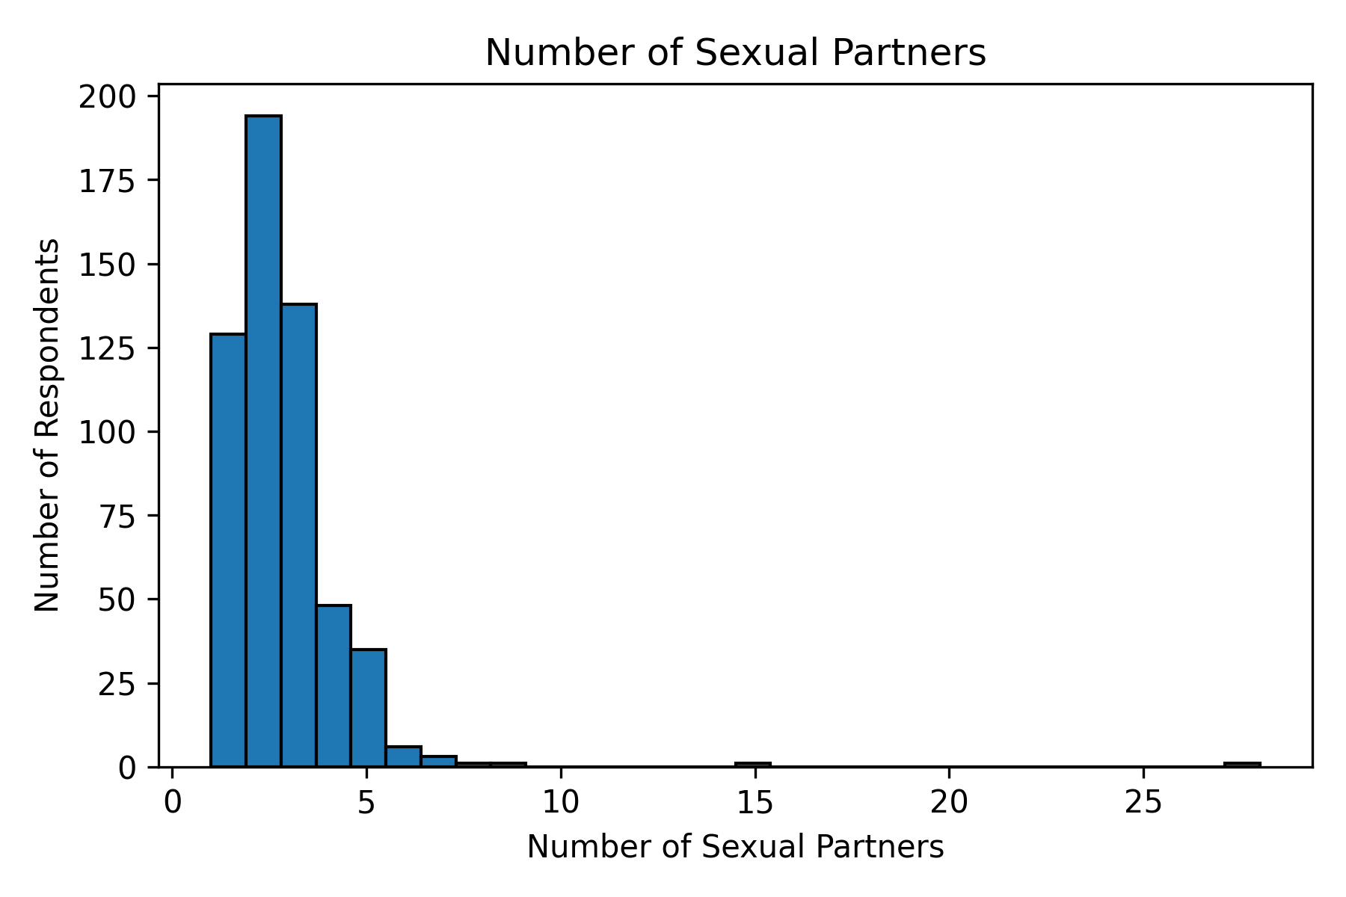

Slide 6
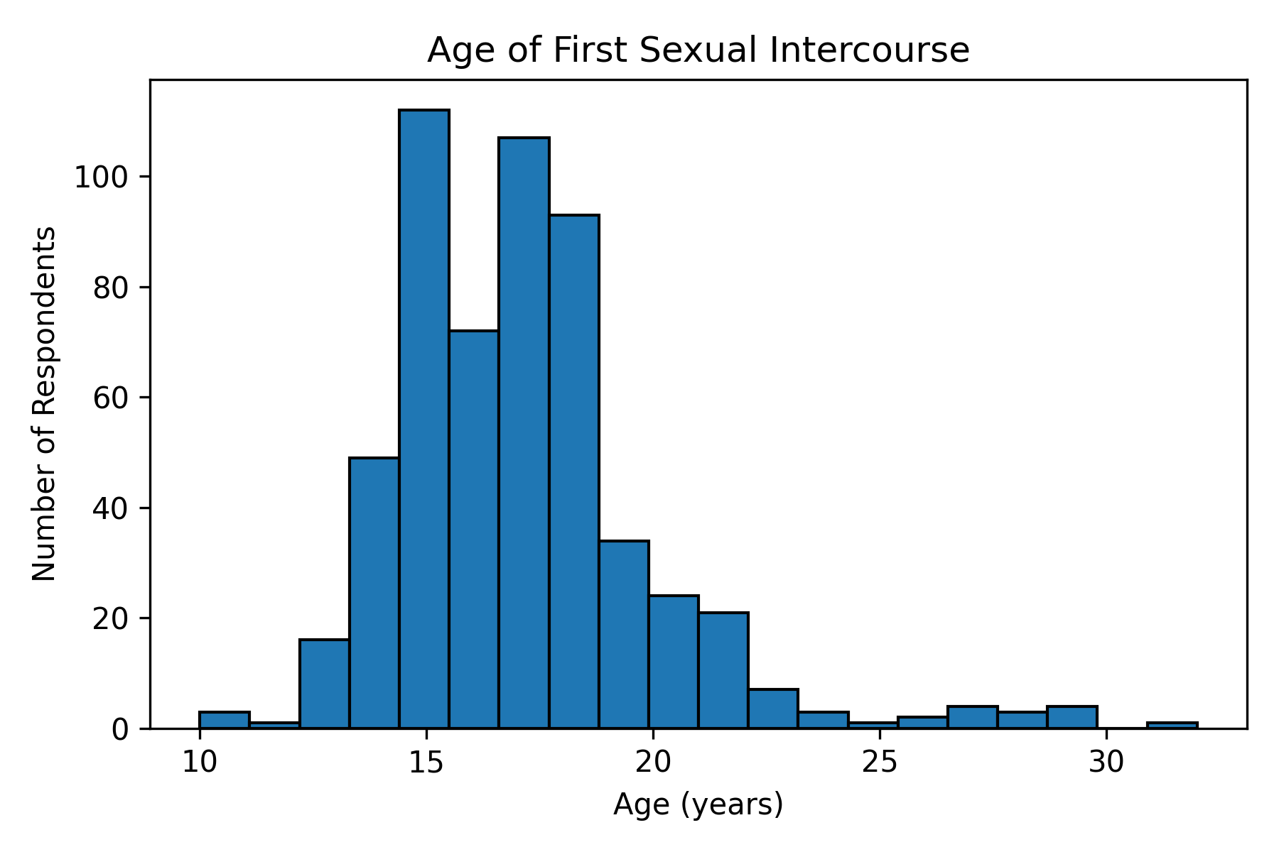

Slide 7
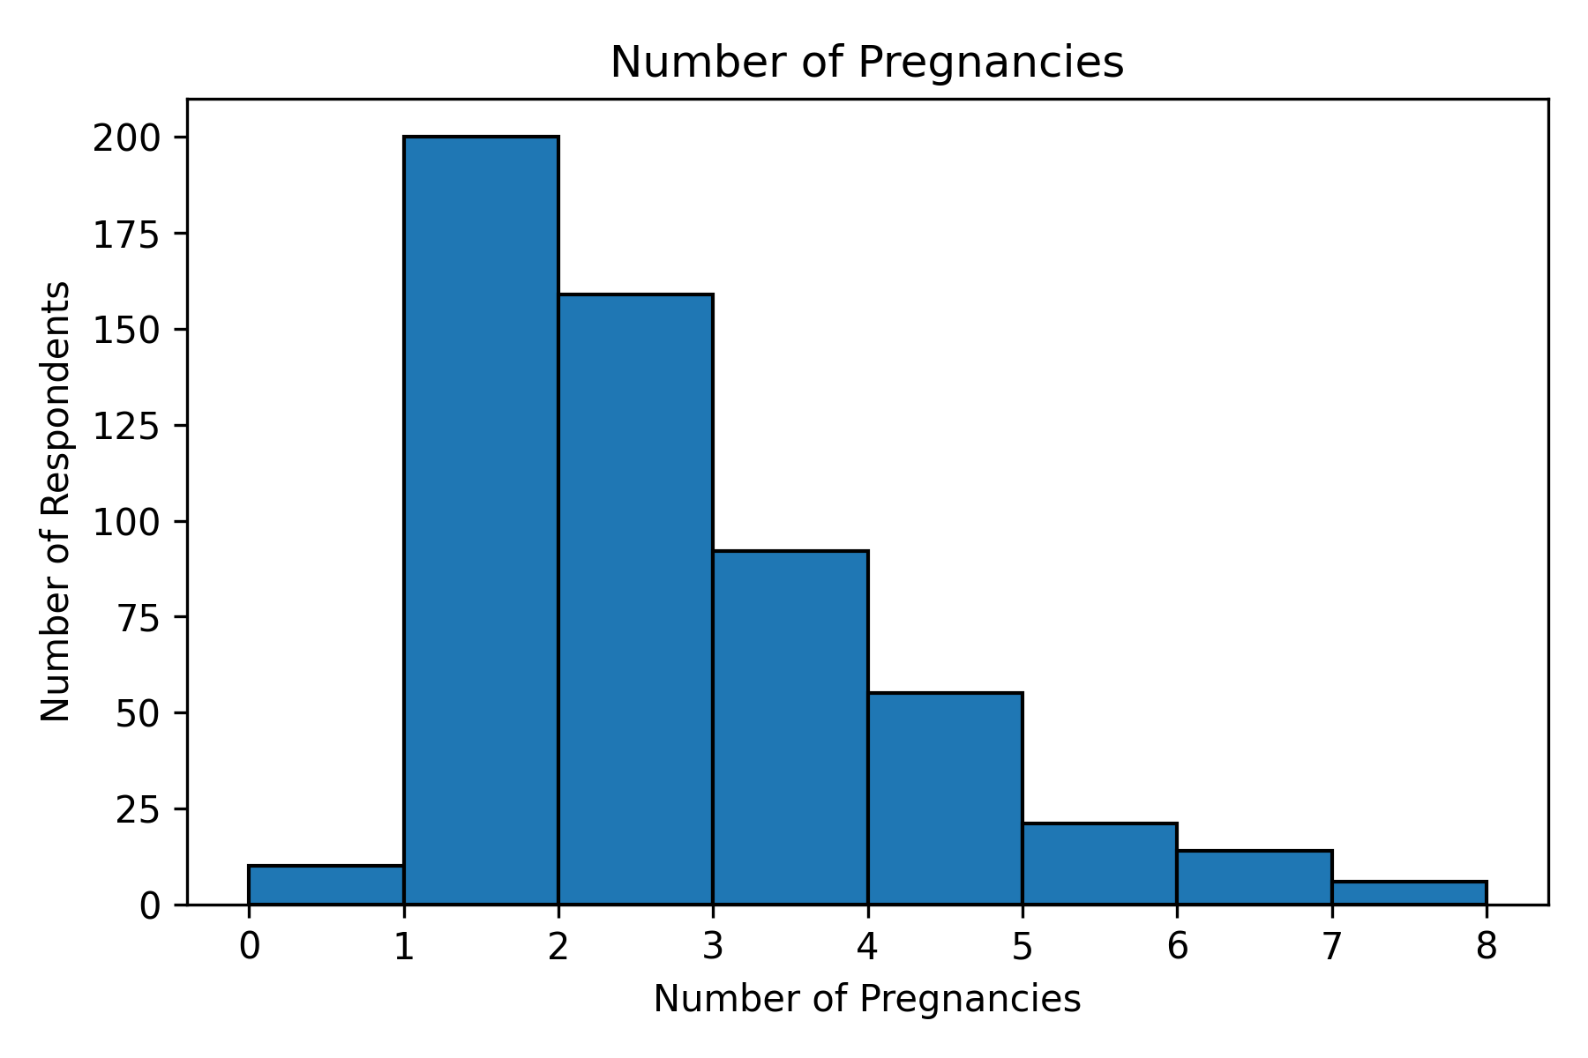

Slide 8
Challenges
Anonymous - pros and cons
Voluntary responses (non-responses = null values)
Sensitive information, subject to response bias
Multiple diagnostic procedures
Sample size/bias

